Slide 1

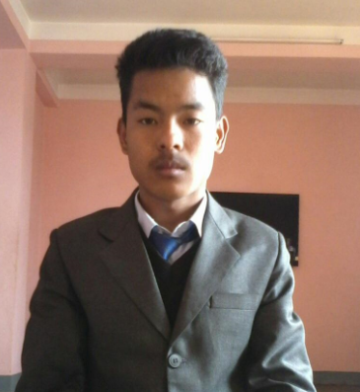


Prepared and Presented By:- Mr. Shishir Shrestha Mr. Aashish Shrestha Mr. Rajesh Kafle Ms. Rojina Dhakal Topic : Marksheet Management Bsc.CSIT- 1st Semester MBM college

Slide 2
Introduction
A better way to evaluate the student and his/her characters.
Way to know about progress of student.
Also can be said as a report card distribution.
File handling is going to be use for the effective implementation of all the typical features of this project

Slide 3
Objectives
To create a project using C-programming and its features.
To implement features like control statement, structures and file handlings.
To be familiar with resource reusability by making user defined function.
To make the program easy while running it.
To concise the memory of program as far as possible.
To get an idea about making a simple project using C.
To be able to solve problems by Compiling and Debugging.

Slide 4
Key feature of project
Create student mark sheet record.
Read specific student’s mark sheet record.
Display all students’ grade report.
Modify student’s mark sheet record..
Delete student record.

Slide 5
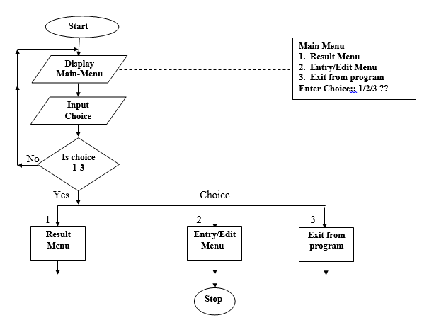
Algorithm and Flowchart
Step 1. Start
Step 2. Enter choice <1-3>
If choice is 1 go to step 3, go to step 6
If choice is 2 go to step 4 , go to step 6
If choice is 3 go to step 5 , go to step 6
Step 3. Call result menu
Step 4. Call entry/edit menu
Step 5. Exit from program
Step 6 Stop

Slide 6
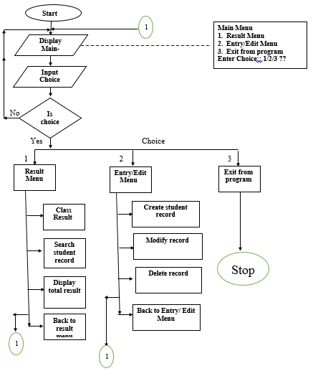

Slide 7
Create student mark sheet record
void create() function is going to be used.
Creates a new student record containing students required information .
Information may be as :
Student name
Student roll no.
Marks obtained by students in 5 subjects i.e. IT, C, Statistics, Calculus and Probability.

Slide 8
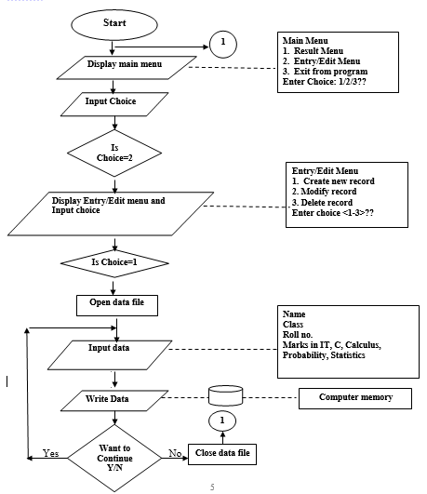
Flowchart

Slide 9
Read specific student’s mark sheet record
void search() function is going to be used.
It is used to search the record stored of a specific student.
It can be accessed through roll no.
It reads students name, roll no., marks obtained in mentioned subjects.
It displays the percentage obtained by all students .
It displays the grade achieved by the student.

Slide 10
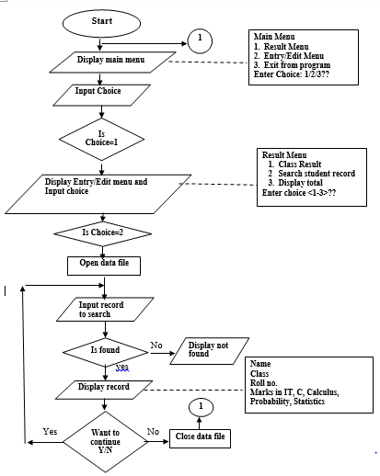
Flowchart

Slide 11
Display all students’ grade report
void display_total() function is going to be used here.
This feature enlists all the students’ record saved in file.
The grade report is displayed in a tabular form.
It includes roll no. and name of the students, marks achieved in the five subjects, and the grade and percentage obtained by them

Slide 12
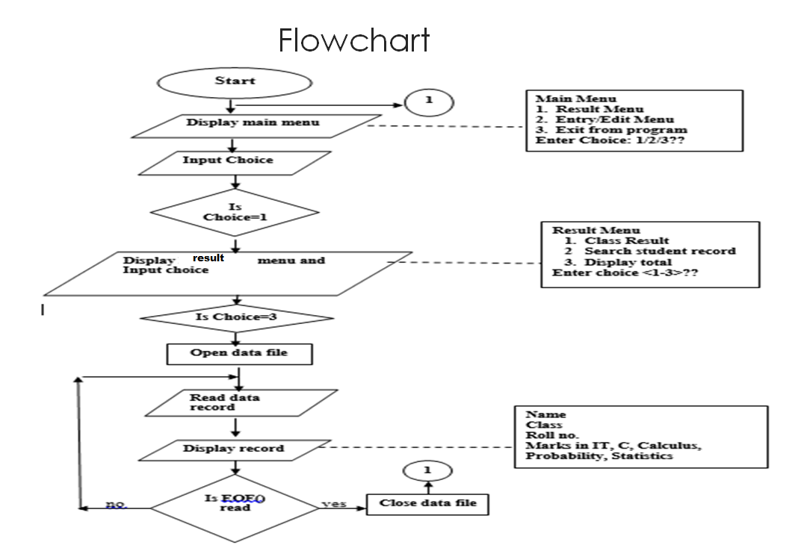

Slide 13
Modify student’s mark sheet record
void modify() function is going to be used here.
It helps to modify the record of students stored previously.
It may change the roll. no, name, marks obtained in mentioned subject along with grade, percentage as per user requirement.

Slide 14
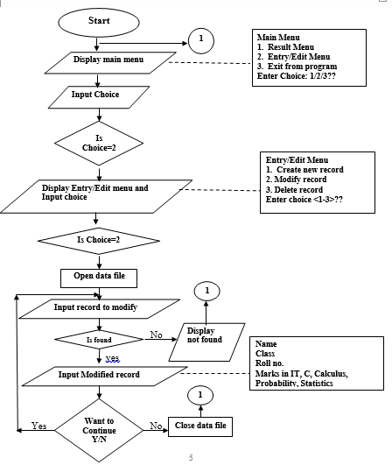
Flowchart

Slide 15
Delete student record.
void delete() function is going to be used here.
This features helps to delete the unnecessary record stored in file .
It deletes all the information such as students name, roll no. , marks, grade, percentage.

Slide 16
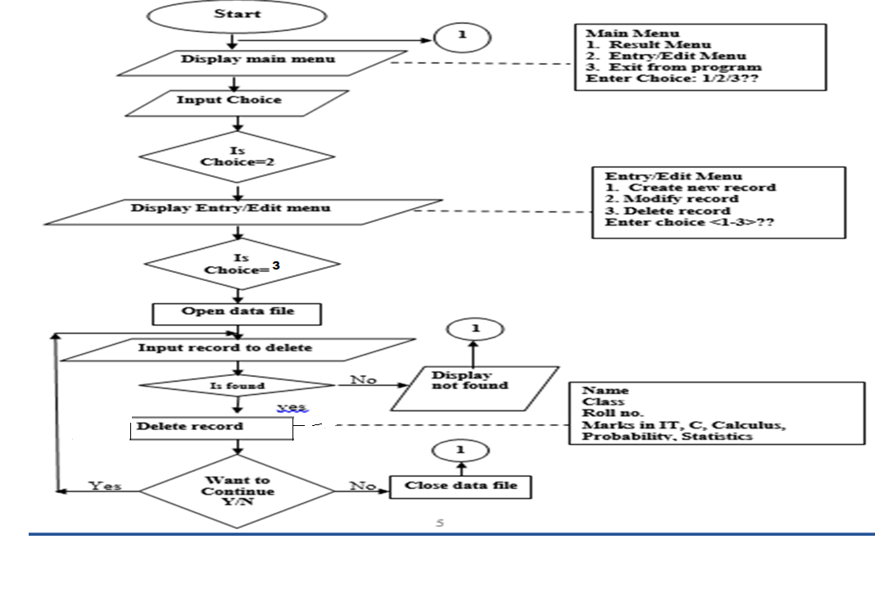
Flowchart

Slide 17
Header files to be used
#include <stdio.h>
#include <string.h>
#include <conio.h>
#include <stdlib.h>
#include<graphics.h>

Slide 18
Some other terms to be used
Control statements
Switch statements
Operators like conditional, arithmetical.
Functions.
Arrays and Strings
Pointers
Structure
File handling

Slide 19
Conclusion
A predicted model of project .
Some small thing may vary but overall the pattern remain same.

Slide 20
ANY QUERIES ??

Slide 21
Thank You !!!

